Slide 1
JOBMONSTER
Robust, user friendly website

Slide 2
COntext
To provide jobs to various inter-state and intra state worker which are both skilled and unskilled.
Providing labourers interaction with employers so that they can be clearly clarified about any job they are wishing to do.
Ensuring safe and friendly environment to labourers.
Employers can list multiple vacancies for a single post.
Labourers can come from all over India to respective state in which they seeking job.

Slide 3
Challenges
01
02
03
04
05
06
PROVIDING USER-FRIENDLY WEBSITE
Quick and Quality Environment
Technology
Ensuring robust,user-friendly,multinigual platform to regulate Intra and Inter state migrant.
Providing quality and quick employement to build a caring,humane society.
Technology empower the labourers through education and digital skill training.
Transparency
administration
Responsiveness
Clarifying every information on a specific opportunity.
Giving administartion control to restructure form by adding and removing form fields.
Works in both mobile and desktop.

Slide 4

Our company
Jobmaster is the platform for connecting skilled and unskilled labourers with the employers. Labourers can access various jobs and enquire about it so that they are fully covered and take decision easily without any hustle.

Slide 5
What we are working on
Creating employement
Easy to help employers to find labourers
Uplifting unskilled worers by providing them jobs

Slide 6
----------------------------------------------------------------------------------
“He who works with his hands is a laborer. He who works with his hands and his head is a craftsman. He who works with his hands and his head and his heart is an artist.”

Slide 7

Future
Future of Jobmonster is to reach to every skilled and unskilled labour who can best find his job with highly safe and friendly environment . Jobmonster is expecting to have a large database in coming years.

Slide 8
10,000,000
Big numbers catch your audience’s attention

Slide 9
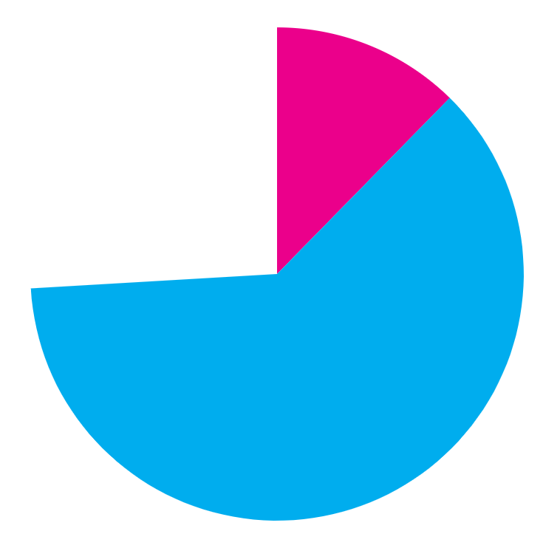
Predicted results
Unskilled workers
More unskilled workers need more awareness to find the best out of them
Skilled workers
Skilled workers need to be updated with their skills time to time.
Employeers
Employeers provide multiple vacancies for each job post.
------------------------------------------------------------------------------------------------------------------

Slide 10
Fonts & colors used
This presentation has been made using the following fonts:
Staatliches
(https://fonts.google.com/specimen/Staatliches)
Work Sans
(https://fonts.google.com/specimen/Work+Sans)
#ffffffff
#eb008b
#1f1a6b
#00adee

Slide 11
Team united Spirits
Pranzal sharma
Himanshu bansal
Harman
harsh

